Slide 1

Matt Haines
Software Engineer
matt@electricimp.com

Slide 2
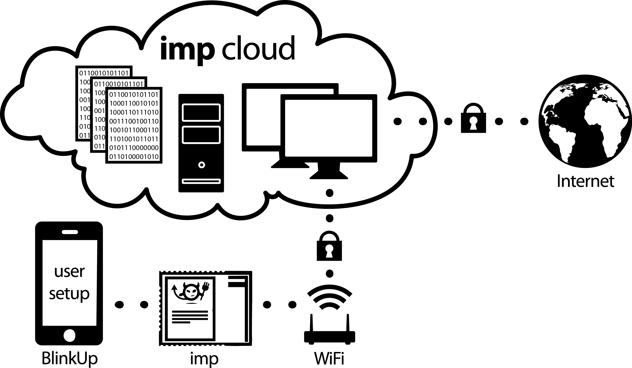

Slide 3
Demo!

